Slide 1
ANSU MEDICINE CENTER
Health Is Wealth

Slide 2
Over view
Ansu Medicine is an online store for saving and keeping accurate track of drug present in the pharmacy. It is easy to use and it a real time data saving wit enhance features.

Slide 3
FEATURES
User Login
User Registration
Password Protection
Adding Of Multiple Users
Dashboard
Dosage Plans
Lists Of All Medicine
Save New Medicine
Delete option

Slide 4
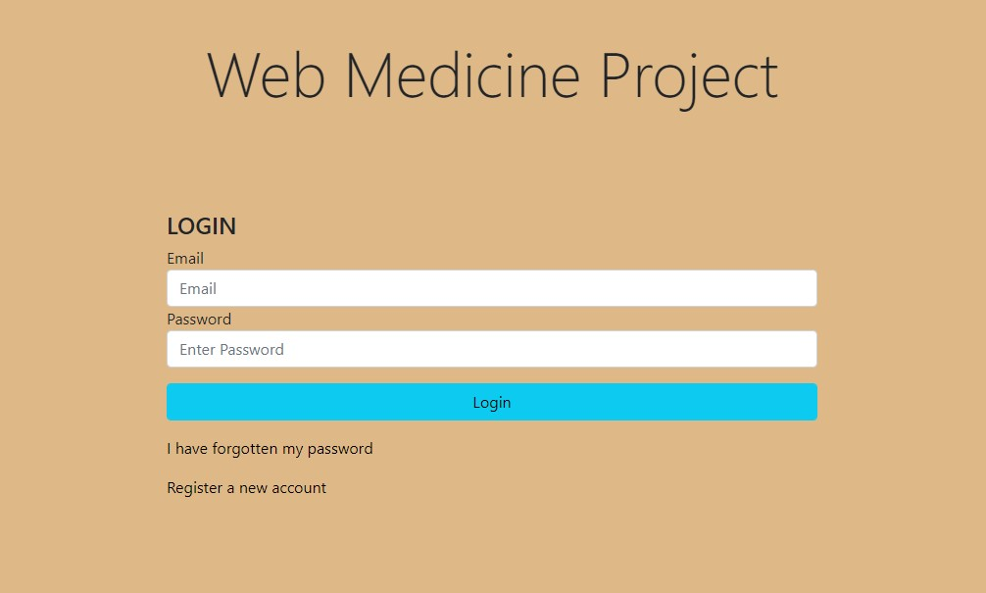
USER LOGIN
User Login is to protect data. By only giving access to register user to access the dashboard.

Slide 5

USER REGISTRATION
User Registration, this use to add user information added that the user will have the access to login.

Slide 6
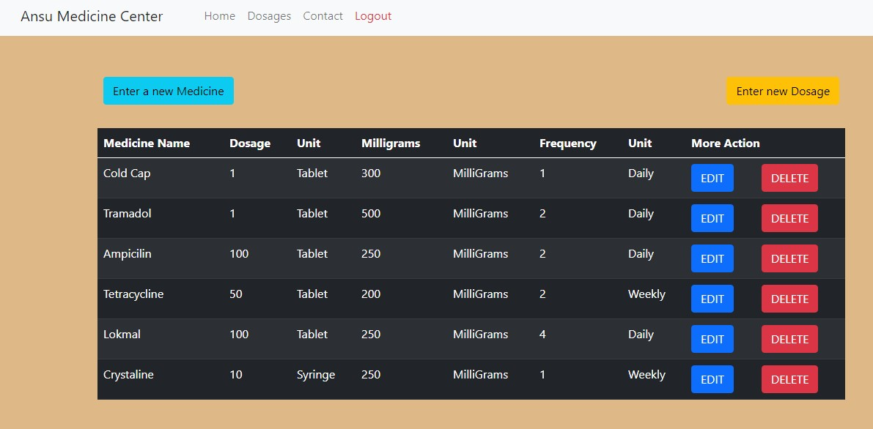
DASHBOARD
The Dashboard is use to add drugs, delete and perform other functions.

Slide 7
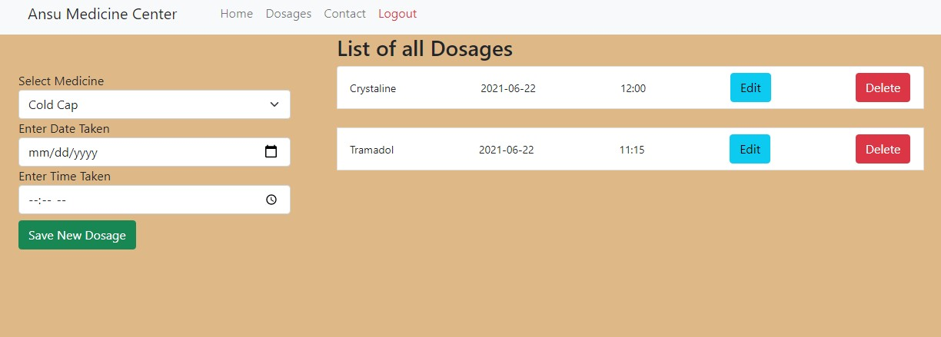
Dosage Plans
The Dosage Plans, it keep track of dosage , it can be edit, delete, and add.

Slide 8
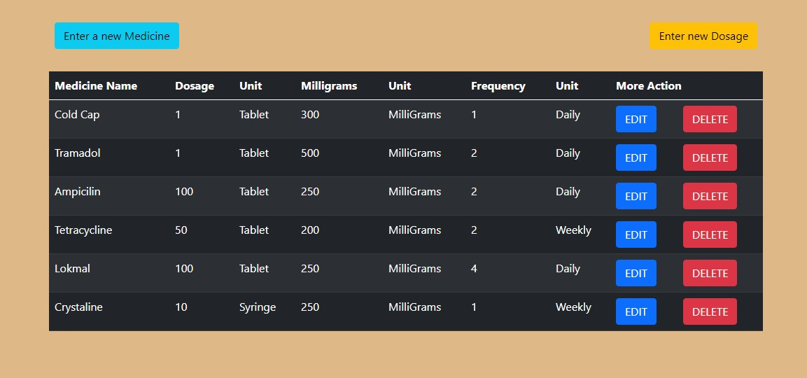
List Of All Medicine
List of all medicine. This panel display the drugs in list.

Slide 9
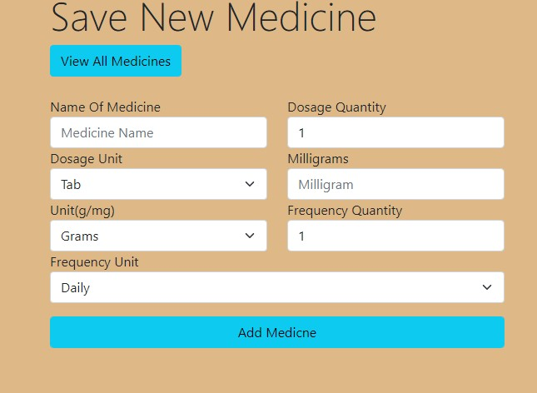
Save New Medicine
Save New Medicine, Allow user to add new drugs.

Slide 10
Info
Program = Computer Science
Year = Year(4)
Name = Andrew Ansu Conteh
ID = 32700
Module = COMPS 461

